Slide 1

Is My Project on Schedule?
Jeff Jasper

Slide 2

Background: Kentucky Transportation Center charged to research & develop…
Critical Path Method for
KYTC Project Development
Notes:
3 year project and we’ve completed first year

Slide 3
Critical Path Method for KYTC Project Development
TASK
1
Review current KYTC policies, procedures, and manuals describing project development process. Examine FHWA, AASHTO, and other publications that discuss project development process.

Slide 4
Critical Path Method for KYTC Project Development
TASK
2
Identify typical KYTC highway projects and phases. Create several high-level CPM templates for these typical projects and common project phases.

Slide 5
Critical Path Method for KYTC Project Development
TASK
3
Future training… (stay tuned)
KTC will develop and deliver training on the critical path method.
Notes:
This is the plan for year three…so stay tuned.

Slide 6
THE TEAM
Jennifer McCleve (KYTC)
Jeff Jasper (KTC)
Candice Wallace (KTC)
Sarah McCormack (KTC)
Bryan Gibson (KTC)
Darrin Eldridge (KYTC - Chair)
Karen Mynhier (KYTC)
Rachel Catchings (KYTC)
David Waldner (KYTC)
Dean Loy (KYTC)
1
6
2
7
3
8
4
9
5
10

Slide 7

Required Components for Critical Path
• Work Breakdown Structure
• Dependencies between the Work Activities
• Work Activity Durations
• Logical Endpoints such as Milestones or Deliverables

Slide 8
3/1
3/3
3/5
3/7
3/9
3/11
3/13
The Gantt Chart
Graphical Representation of the Entire Project
Time Scale listed on the X-axis; Activities on the Y-axis
Durations for activities represented in bar chart format
Internal relationships represented by placement of the bar on the Gantt Chart

Slide 9
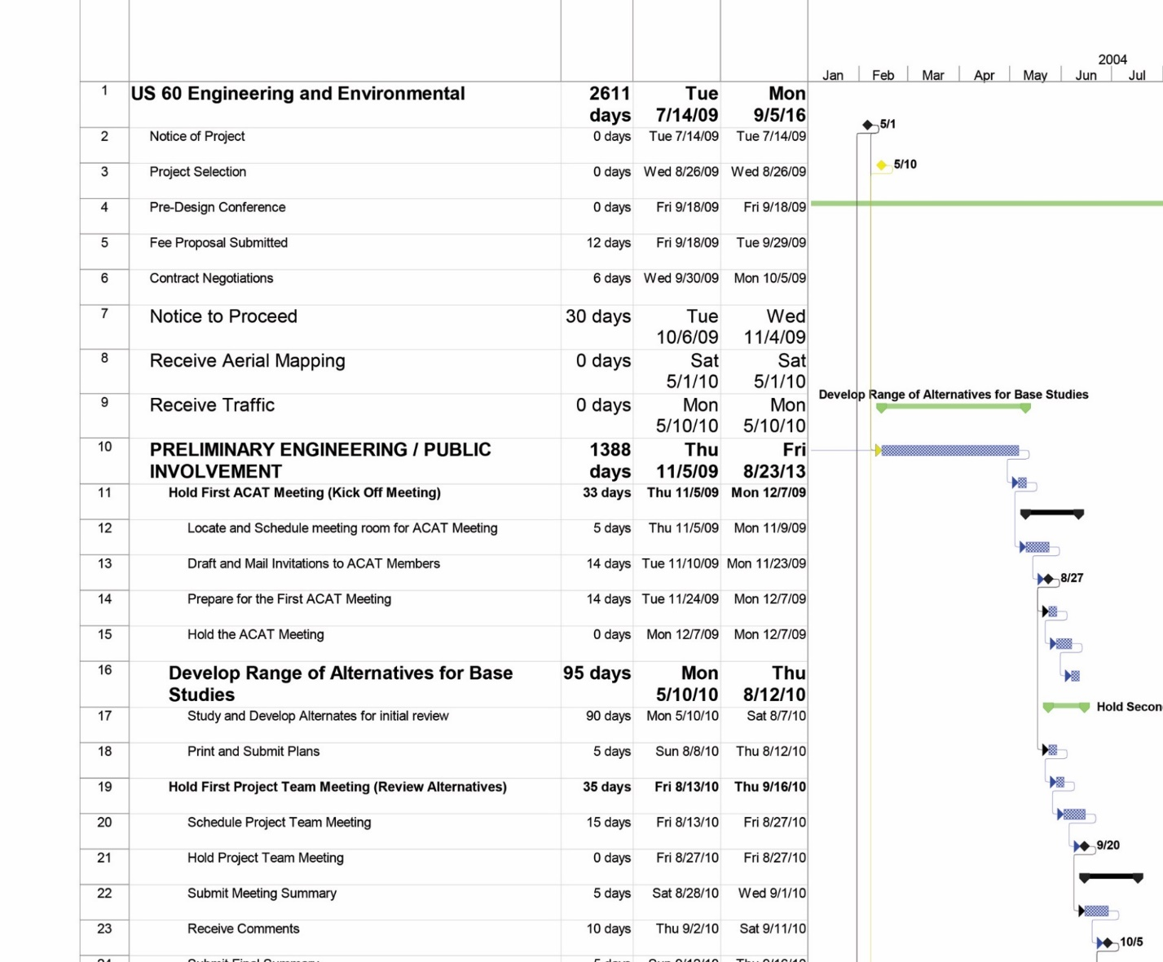
The Gantt Chart: Graphical Representation of the Entire Project
U.S. 60 Engineering & Environmental

Slide 10
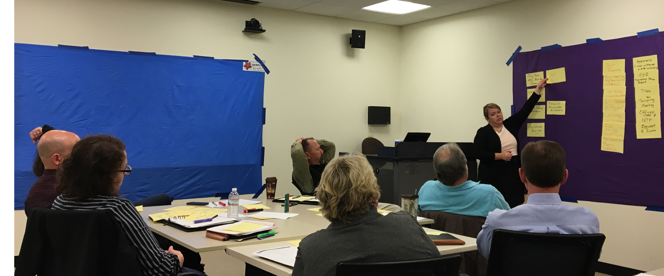
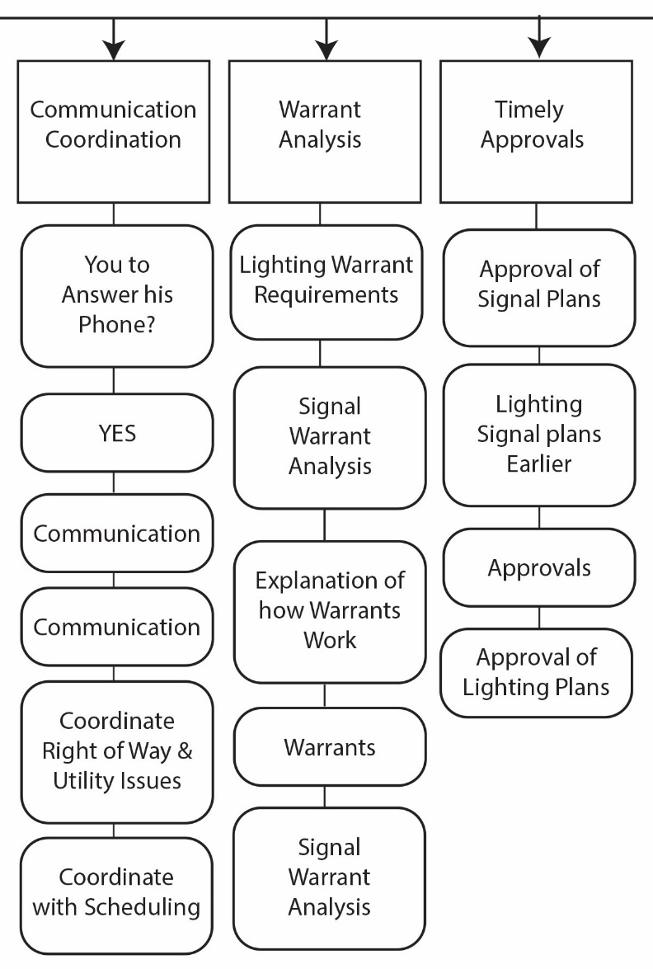
Work Breakdown
Structure
Communication Coordination
Warrant
Analysis
Timely
Approvals
Subdivides project deliverables and project work into smaller, more manageable components
You to answer
his Phone?
Lighting Warrant Requirements
Approval of
Signal Plans
YES
Signal Warrant
Analysis
Lighting Signal plans
Earlier
Communication
Communication
Explanation of how Warrant Works
Approvals
Coordinate Right of Way & Utility Issues
Warrants
Approval of
Lighting Plans

Slide 11
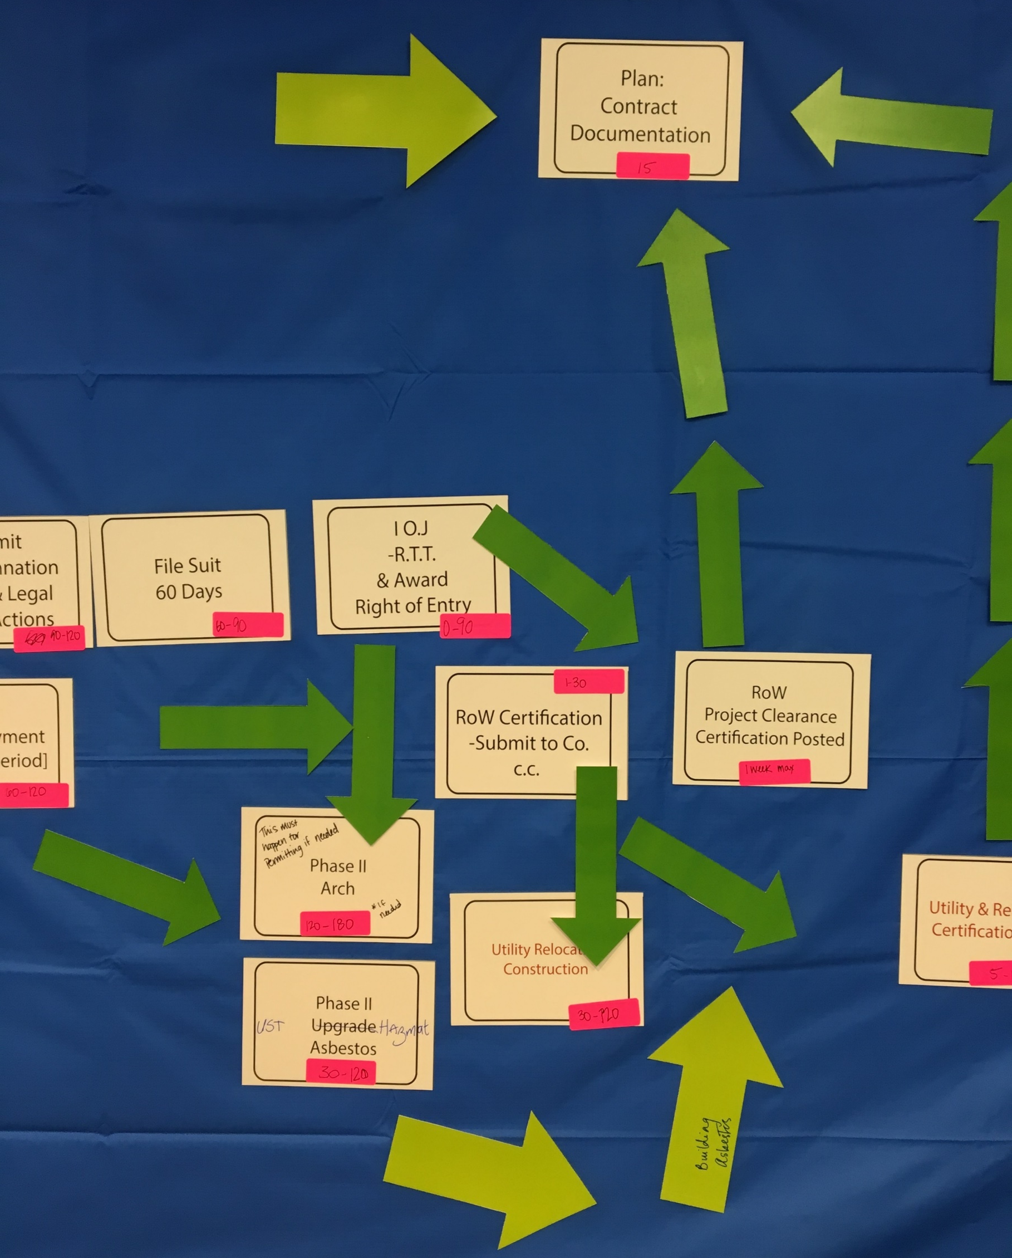
How Do We Define Dependencies?
Definition
A dependent or subordinate activity; relationships among tasks which determine the order in which activities need to be performed

Slide 12

How Do We Define Durations?
Expert Judgement
Analogous Estimating
Parametric Estimating
3-point Estimating
  Optimistic, Pessimistic, Most Likely
Group Decision-Making Techniques
Notes:
Analogous cost estimating is frequently used to estimate a parameter when there is a limited amount of detailed information about the project, for example, in the early phases of a project. Analogous cost estimating uses historical information and expert judgment. Analogous cost estimating is generally less costly and time consuming than other techniques, but it is also generally less accurate.
Parametric estimating uses a statistical relationship between historical data and other variables (e.g., square footage in construction) to calculate an estimate for activity parameters, such as cost, budget, and duration. Concrete bridge deck is $125/square foot.

Slide 13

KYTC’s Project Development Process
Prioritization of the Projects
Prioritization “yo-yo”?
We muddle through it.
Notes:
Ask question: “What does a KYTC PM do when a project get de-emphasized? Or the reverse: emphasized to top priority?”
For the on-again, off-again project yo-yo’s…when it is hot one day and seemingly dead the next: muddle through it. We do the best we can, be proactive if we can, and respond accordingly if we can’t.
We know this is difficult for consultants to manage, but it’s difficult for us as well. We make commitments to the public, stakeholders, elected officials, etc. then fail to deliver. So what do we do? We adjust our schedules and priorities and move forward.

Slide 14
KYTC’s Project Development Process
Durations for Our Projects
Minimum (Urgent!) or
Average/Standard
Notes:
Ask question: “What does a KYTC PM do when a project get de-emphasized? Or the reverse: emphasized to top priority?”
For the on-again, off-again project yo-yo’s…when it is hot one day and seemingly dead the next: muddle through it. We do the best we can, be proactive if we can, and respond accordingly if we can’t.
We know this is difficult for consultants to manage, but it’s difficult for us as well. We make commitments to the public, stakeholders, elected officials, etc. then fail to deliver. So what do we do? We adjust our schedules and priorities and move forward.

Slide 15
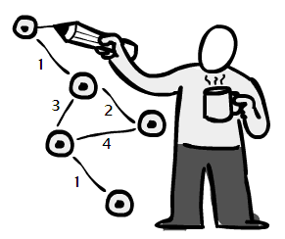
Managing the Critical Path
Critical Path lets you know where you do and do not have flexibility
If the project is falling behind adding resources to non-critical path activities will not get you back on track
The critical path can change

Slide 16
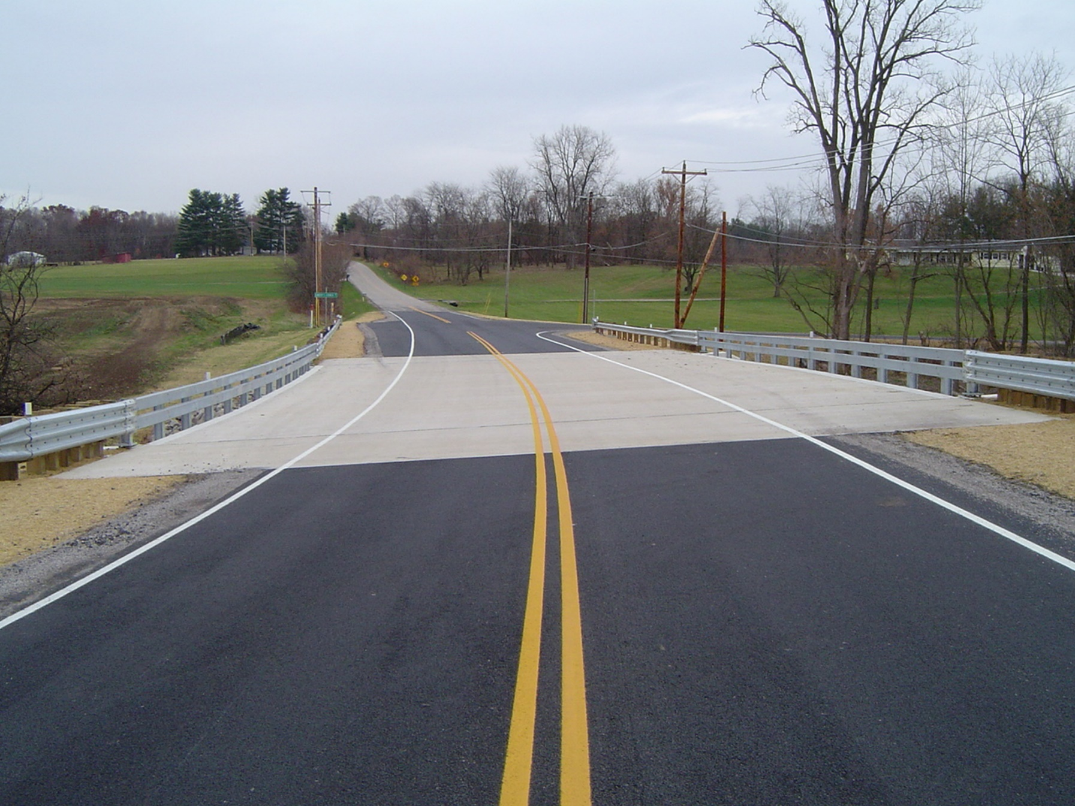
Project Contexts
Rural Federal Bridge Replacement CE I
Urban Federal Bridge Replacement with Railroad CE I
4 Mile Rural Road Widening into Urban Intersection EA FONSI
Notes:
In order to create a project timeline, we had to make several assumptions. We decided to create project contexts so we could frame up the project timelines. The project contexts we chose are….

Slide 17

KYTC’s Goal for
Projects
Delivering the project within scope,
with quality,
on time,
& within budget

Slide 18

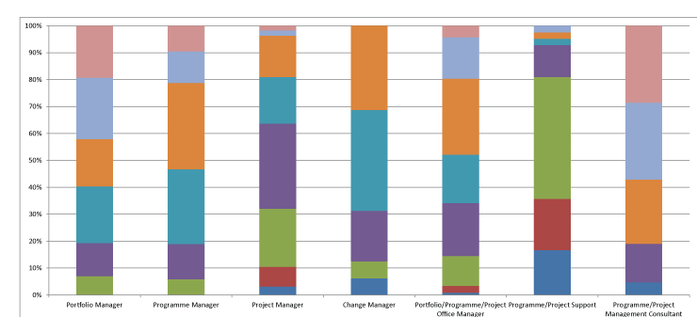
How do you Define an “Average Project”?
Notes:
Ask Question:
How do you define a average highway project?
[Darrin will engage the participants. Hopefully the class will acknowledge that “average” is difficult to define with highway projects. There are similarities, but each project is different from the others.]

Slide 19
AVERAGE
Definition
Adjective: typical; common; ordinary
Synonyms
Mediocre, Moderate, Ordinary, Regular, Boilerplate,
Commonplace, Familiar, General, Humdrum, Mainstream,
Standard, Customary

Slide 20
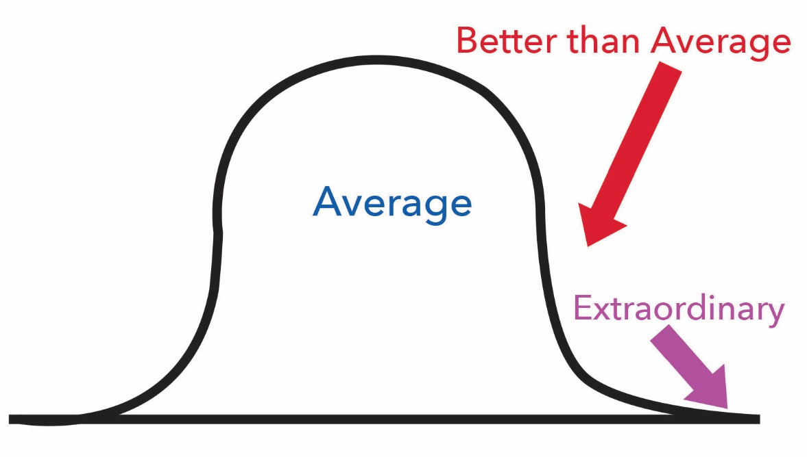
average, Better Than Average and, EXTRAORDINARY
Notes:
Read:
When we think of average, we think of charted data and graphs and the ability to measure something about the topic. From those measures we can average the numbers to come up with a central or typical value in a set of data.
Our projects may have some trackable statistics in which “average” is useful. Numbers like average cost or average duration. However, the details of our projects don’t lend them self to “average”.

Slide 21
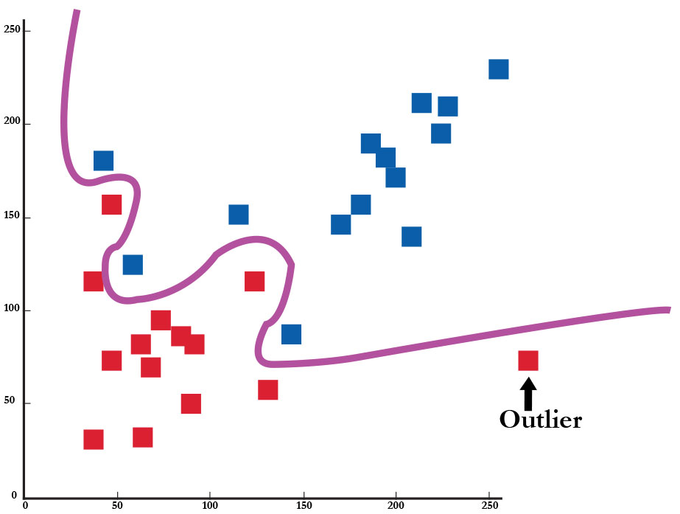
average, Better Than Average and, EXTRAORDINARY
Notes:
Read:
If we try to statistically value and record our highway projects, there is no average. Every project is unique. They have great variety in their purposes, solutions, impacts, form, their development, and on and on. There are similarities, but each project ends up being different. They are different and many times have to be managed in a way that recognizes their uniqueness.
To quote me, “We’ve built all the easy ones’

Slide 22
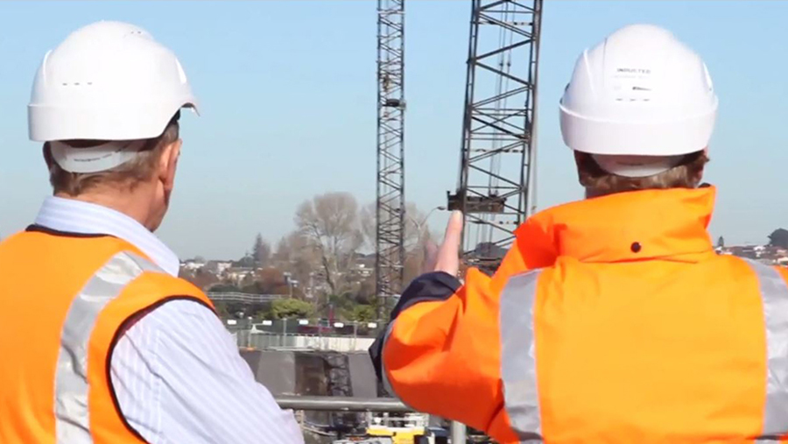
Project Contexts
Rural Federal Bridge Replacement CE I
Urban Federal Bridge Replacement with Railroad CE I
4 Mile Rural Road Widening into Urban Intersection EA FONSI (next year)
Notes:
In order to create a project timeline, we had to make several assumptions. We decided to create project contexts so we could frame up the project timelines. The project contexts we chose are….

Slide 23
“Standard” Rural Federal Bridge Replacement CE1
Standard Rural Bridge Replacement
Environmental (CE I)
  Track for Archeology & not
  Track for Asbestos & not
Right Of Way
  4 to 6 parcels, some appraisals, some MARs, no relocations, a miscellaneous move (i.e. barn)
  Two paths tracked: ROW Acceptance and Condemnation
Utilities Overhead and In-ground
  A few overhead poles, underground water line
Time durations for minimum (urgent project!) and average/standard

Slide 24
“Standard” Rural Federal Bridge Replacement CE I

Slide 25
“Standard” Rural Federal Bridge Replacement CE I

Slide 26
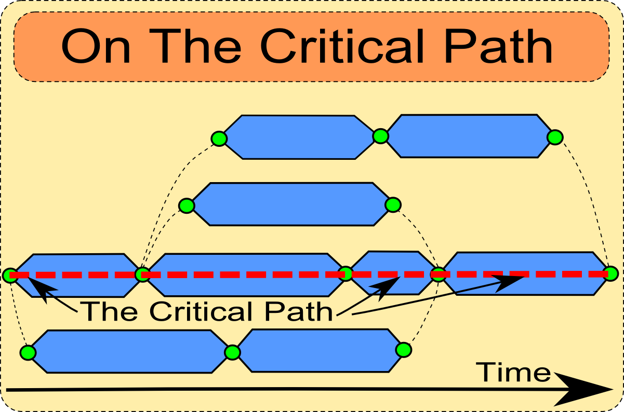
Discussion
Item:
In KYTC’s Project Development Process…
…the environmental
process often drives
Phase 1 Project Work.
Notes:
Read: “The environmental process often drives preliminary engineering. The consultants should assemble the appropriate team to lead this process. Although the consultant project engineer should be working directly with the PM, he (or the environmental leader on his team) should be prepared to coordinate with the district EC’s and DEA SME’s at the PM’s direction. Environmental contract negotiations will be performed by the DEA SME’s. The consultant should be prepared to negotiate with the appropriate SME’s while keeping the EC and PM informed.”
Note: Different PM’s may handle this differently. Some may want the consultant environmental lead coordinating directly with the Environmental Coordinator. Some may want everything run through the PM. The key item to remember is to keep the PM in the loop.

Slide 27
Environmental Work Time Durations
Rural Federal Bridge Replacement CE I – Environmental Work Items | Minimum (Urgent!) | Average/Standard
Historic Checklist | 60 Days | 120 Days
Underground Storage Tanks / HazMat | 7 Days | 30 Days
Section 4(f) Resources | 7 Days | 30 Days
Habitat Assessment | 7 Days | 30 Days

Slide 28
Environmental Work Time Durations
Rural Federal Bridge Replacement CE I – Environmental Work Items | Minimum (Urgent!) | Average/Standard
Environmental Issues & Impacts | 7 Days | 30 Days
Finalize Section 106/ Section 4(f) | 60 Days | 90 Days
Phase I Archaeology | 90 Days | 180 Days
Environmental Justice | 45 Days | 90 Days

Slide 29
“Standard” Rural Federal Bridge Replacement CE I

Slide 30
Environmental Work Time Durations
Rural Federal Bridge Replacement CE I – Environmental Work Items | Minimum (Urgent!) | Average/Standard
Biological Assessment | 90 Days | 150 Days
Phase I,II,III Archaeology | 120 Days | 180 Days
Phase II HazMat/Asbestos | 30 Days | 120 Days
Removal of Improvements | 7 Days | 30 Days

Slide 31
Project Time Durations: Minimum (Urgent!)
Rural Federal Bridge Replacement CE I | Phase I | Phase II | Total
Acceptance, No Arch and Asbestos | 1 years 5 months 6 day | 1 years 9 months 1 days | 3 years 2 months 8 days
Acceptance, Arch and Asbestos | 1 years 5 months 6 day | 2 years 1 month | 3 years 6 months 6 days
Condemnation, No Arch and Asbestos | 1 years 5 months 6 day | 2 years 0 months 13 days | 3 years 5 months 20 days
Condemnation, Arch and Asbestos | 1 years 5 months 6 day | 2 years 4 months 13 days | 3 years 9 months 18 days

Slide 32
Project Time Durations: Average/Standard
Rural Federal Bridge Replacement CE I | Phase I | Phase II | Total
Acceptance, No Arch and Asbestos | 3 years 3 months 21 days | 3 years 6 months 6 days | 6 years 9 months 25 days
Acceptance, Arch and Asbestos | 3 years 3 months 21 days | 4 years 0 months 2 days | 7 years 3 months 23 days
Condemnation, No Arch and Asbestos | 3 years 3 months 21 days | 4 years 1 months 1 days | 7 years 4 months 23 days
Condemnation, Arch and Asbestos | 3 years 3 months 21 days | 4 years 7 months | 7 years 10 months 19 days

Slide 33
“Standard” Urban Federal Bridge Replacement CE1
Standard Urban Bridge Replacement
Environmental (CE I)
  Track for Archeology & not
  Track for Asbestos & not
Right Of Way
  8 to 10 parcels, more appraisals, some MARs, 2 relocations, a miscellaneous move
  Two paths tracked: ROW Acceptance and Condemnation
Utilities Overhead And In-ground
  More overhead poles, several underground utilities
Railroad Involvement
Time durations for minimum (urgent project!) and average/standard

Slide 34
“Standard” Urban Federal Bridge Replacement CE I

Slide 35
“Standard” Urban Federal Bridge Replacement CE I

Slide 36
Environmental Work Time Durations
Urban Federal Bridge Replacement CE I with RR – Environmental Work Items | Minimum (Urgent!) | Average/Standard
Historic Checklist | 60 Days | 120 Days
Underground Storage Tanks / HazMat | 7 Days | 30 Days
Section 4(f) Resources | 7 Days | 30 Days
Habitat Assessment | 7 Days | 30 Days

Slide 37
Environmental Work Time Durations
Urban Federal Bridge Replacement CE I with RR – Environmental Work Items | Minimum (Urgent!) | Average/Standard
Environmental Issues & Impacts | 7 Days | 30 Days
Finalize Section 106/ Section 4(f) | 60 Days | 90 Days
Phase I Archaeology | 90 Days | 180 Days
Environmental Justice | 45 Days | 90 Days

Slide 38
“Standard” Urban Federal Bridge Replacement CE I

Slide 39
Environmental Work Time Durations
Urban Federal Bridge Replacement CE I with RR – Environmental Work Items | Minimum (Urgent!) | Average/Standard
Biological Assessment | 90 Days | 150 Days
Phase I,II,III Archaeology | 120 Days | 180 Days
Phase II HazMat/Asbestos | 30 Days | 120 Days
Removal of Improvements | 7 Days | 30 Days

Slide 40
Project Time Durations: Minimum (Urgent!)
Urban Federal Bridge Replacement CE I with RR | Phase I | Phase II | Total
Acceptance, No Arch and Asbestos | 1 years 5 months 6 day | 1 years 9 months 1 days | 3 years 2 months 8 days
Acceptance, Arch and Asbestos | 1 years 5 months 6 day | 2 years 0 months 1 days | 3 years 6 months 6 days
Condemnation, No Arch and Asbestos | 1 years 5 months 6 day | 2 years 0 months 13 days | 3 years 5 months 20 days
Condemnation, Arch and Asbestos | 1 years 5 months 6 day | 2 years 4 months 13 days | 3 years 9 months 18 days

Slide 41
Project Time Durations: Average/Standard
Urban Federal Bridge Replacement CE I with RR | Phase I | Phase II | Total
Acceptance, No Arch and Asbestos | 3 years 4 months | 4 years 0 months 17 days | 7 years 4 months 17 days
Acceptance, Arch and Asbestos | 3 years 4 months | 4 years 0 months 17 days | 7 years 4 months 17 days
Condemnation, No Arch and Asbestos | 3 years 4 months | 4 years 1 months 1 days | 7 years 5 months 1 days
Condemnation, Arch and Asbestos | 3 years 4 months | 4 years 7 months | 7 years 11 months

Slide 42
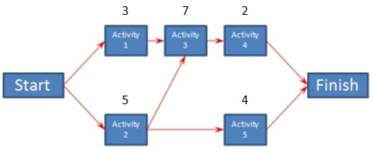
The Engineering Consultant’s
Role:
In KYTC’s Project Development Process
Understand the Critical Path. Be prepared to develop, maintain and monitor critical path method (CPM) diagrams.
Notes:
Get trained; become experts on CPM preparation, editing and analyzing. Make strong recommendations to the PM.

Slide 43
Critical Path Method for KYTC Project Development
Next Steps
Validation of Gantt Charts and Durations
  Rural Federal Bridge Replacement CE I
  Urban Federal Bridge Replacement with Railroad CE I
Create Next Project Context
  4 Mile Rural Road Widening into Urban Intersection EA FONSI

Slide 44
Critical Path Method for
KYTC Project Development
Questions?
Contact Information:
Jeff.Jasper@uky.edu
502-229-0819
Notes:
3 year project and we’ve completed first year

